Slide 1


Summer Internship
Implementing a Faults detection controller in a Charging Station.
Asish Nayak 181030036
Jagannath Lohia 181030030
Jitesh Sonkusare 181030065
Sarvesh Ghadge 181030021
Shamit Savant 181030049

Slide 2
Content
Objectives of our project.
Project timeline for 8 weeks.
Charging Station Protection and controller model on Proteus.
Input sensing in controller design.
Charging Station model on Typhoon HIL.
Charging Station Communication model on Simulink.
Interpretation

Slide 3
Objectives
To create a controller for all possible fault detection in a charging station.
To study the communication circuit between the charging station and EV in Typhoon HIL.
To implement the controller along with the communication circuit in a charging station in simulink.
Finally to simulate a fully functional Fast level 2 AC Charging station with fault protection,communication circuits and display of various parameters such as Units consumed, Estimated time to charge and the final cost of units consumed.

Slide 4
Project Timeline
3
4
5
6
HIL Model
Combining all Individual circuits and arduino coding
Creation of Individual model in simulink
Merging all the individual circuits
2
7
Individual circuit designing on proteus
Analysing the output of the proteus
1
8
Reading research papers
Report and presentation

Slide 5
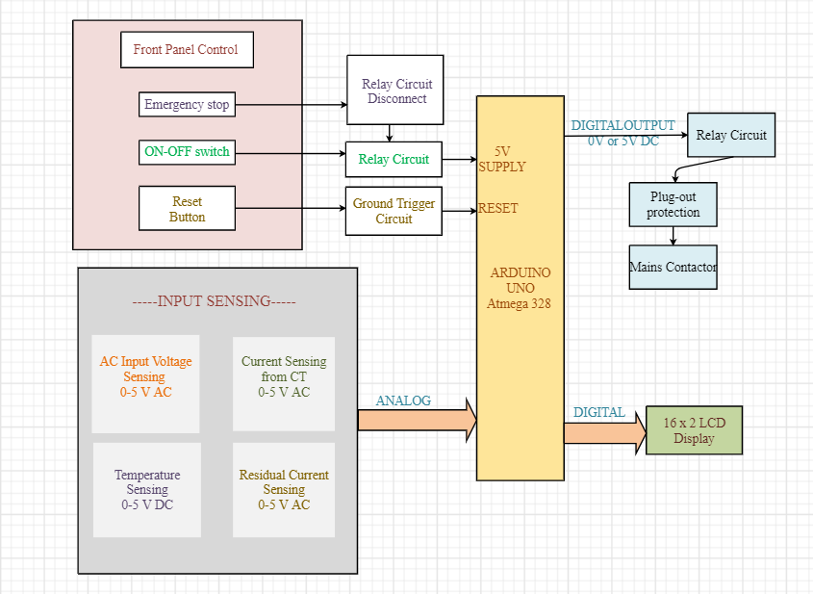
Block Diagram of Charger controller

Slide 6
Input Sensing Block Insights
Current Sensing
Surge protection and AC Voltage Measurement
Senses current using ACS712 hall sensor
Controlling the voltage in a particular limit and reducing the voltage for measurement
Temperature Sensing
Residual Current
Temperature sensing using LM35
Sensing residual current by measuring change in magnetic flux

Slide 7
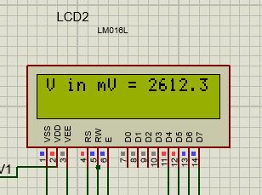
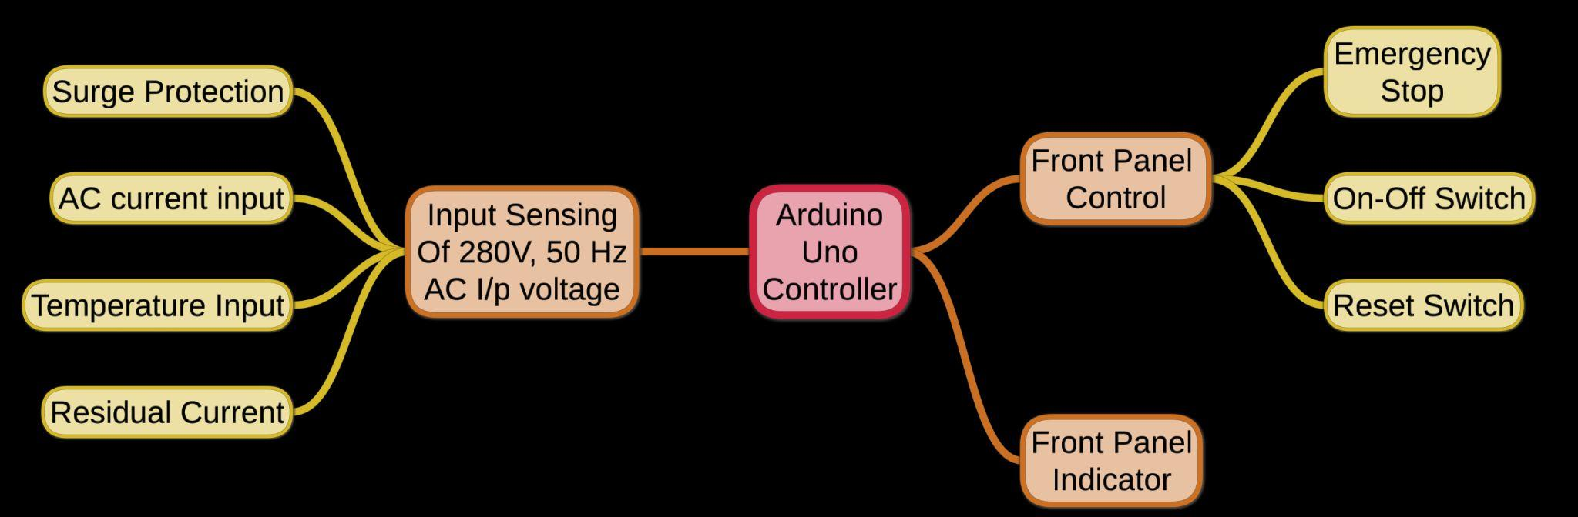
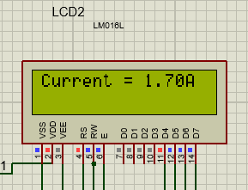
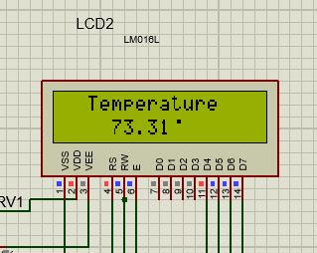
Charging Station Protection & Controller Schematic

Slide 8
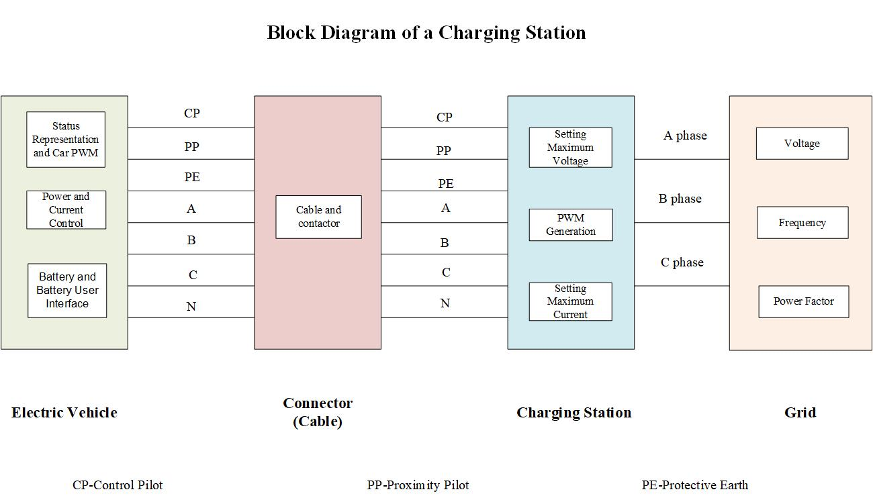
HIL Model of EV Charging Station

Slide 9
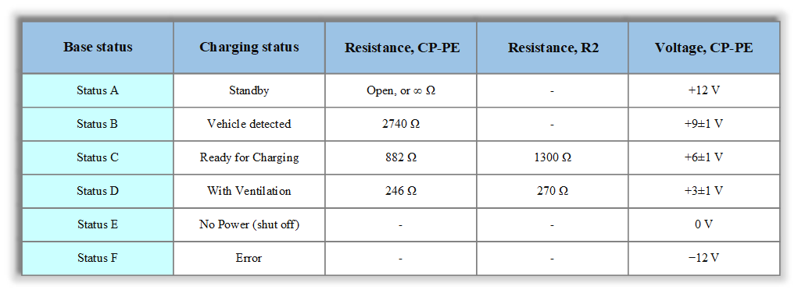
Status Representation of
Communication of EV and Station

Slide 10
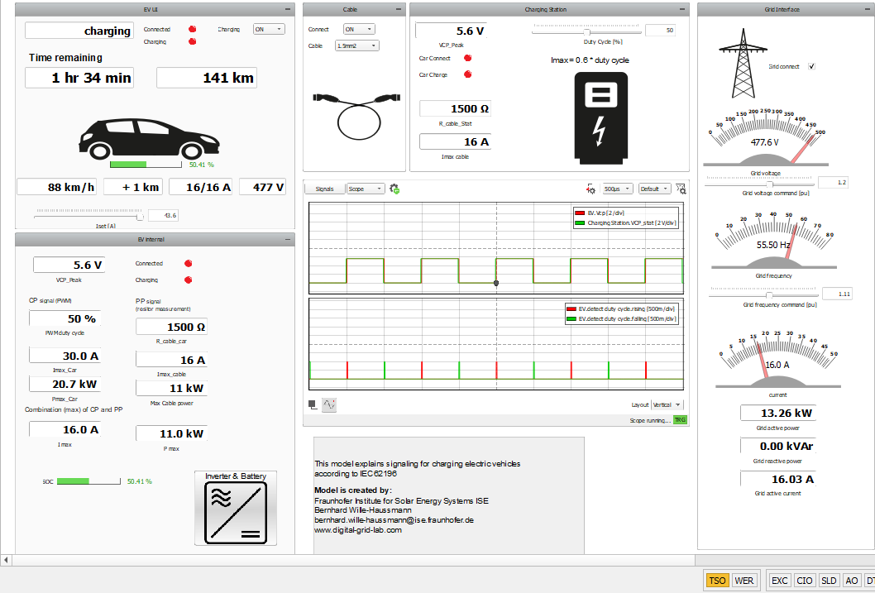
Output of Charging Station on
Typhoon HIL

Slide 11
Interpretation
Charger controller requires input sensing and front panel control with indicator connected with arduino. If any fault such as overcurrent fault occurs it is detected by respective part of the controller circuit and measures are taken to prevent damage to EVSE and Electrical Vehicle.
For the charging station, we can mainly set the duty cycle and observe the status decided by Vcp. The cable allows us to connect the EV and to select a cross section of the applied cable. These include the detected DC, maximum current, and the detected status. The scope in the middle shows the Vcp on the EV side, including the detected edges from duty cycle detection.

Slide 12
THANK YOU

